Slide 1
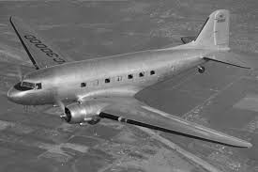
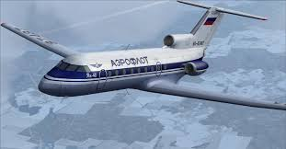
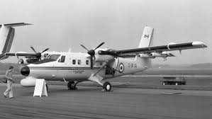
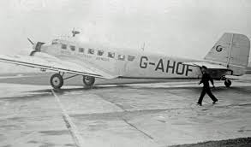
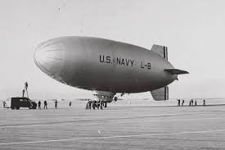
Analysis of Historical Airplane Crashes

Slide 2
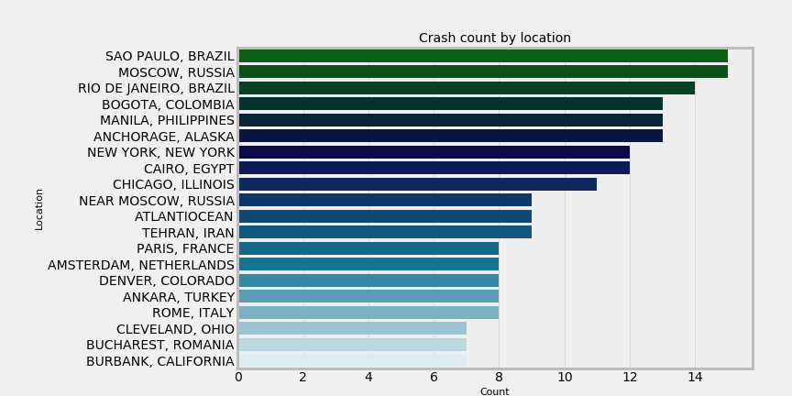
Crashes by Location
Does the crash location have anything to do with the actual crash cause?

Slide 3
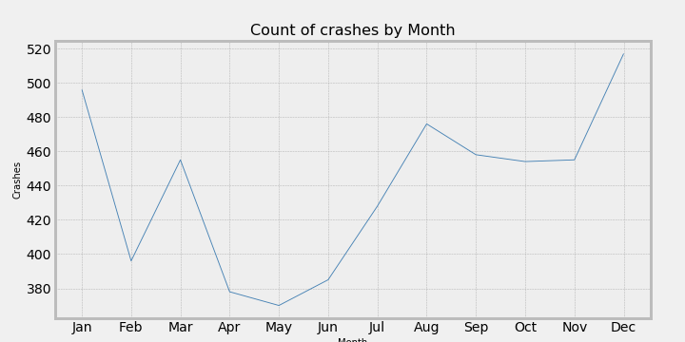
Crashes by month
Does the season effect the probability of a crash?
Most crashes tend to happen in the winter months.

Slide 4
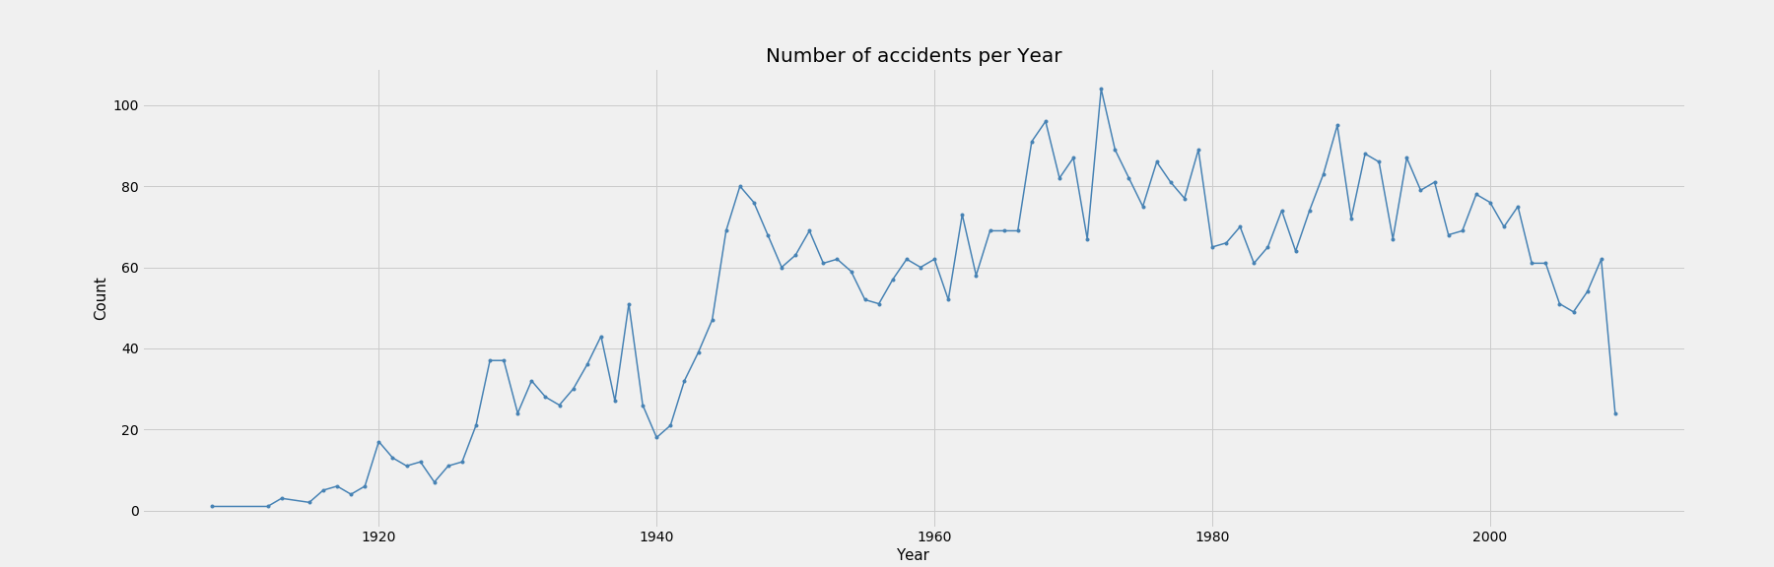
Number of Crashes per Year
What caused the sharp increase in the early 1940’s? This was during World War II
Highest number of crashes take place in the 1970’s, Vietnam war.
Earlier flights could only fly short distances due to fuel and weight limitations. This increased the chance of crashes because of the multiple takeoffs and landings.
Crashes seem to decline after the 1990’s, safety regulations put in place.

Slide 5
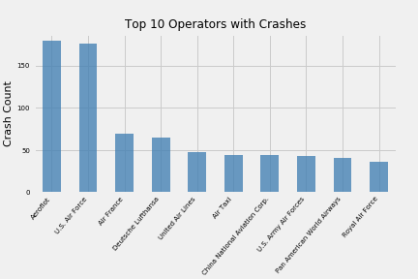
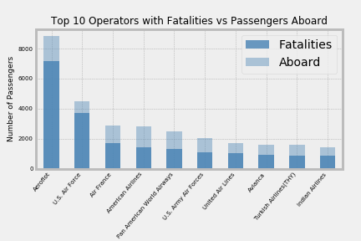
Operators with the highest number of crashes and Fatalities vs. Number of passengers aboard.
Only three of the top operators with the highest number of crashes are military.
Among the Operators with the most fatalities, most have a fairly good survival rate.
Aeroflot is one of the oldest airlines in the world, starting in 1923. During the Soviet Era (1922-1991), Aeroflot was the Soviet national airline and the largest airline in the world

Slide 6
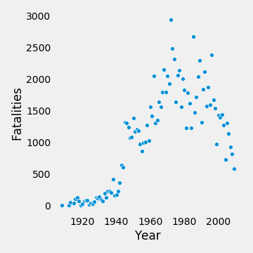
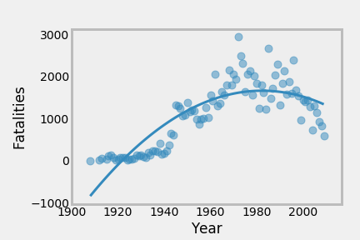
Fatalities by Year

Slide 7
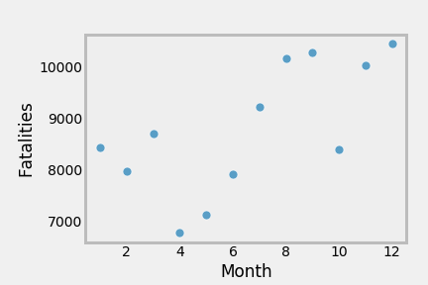
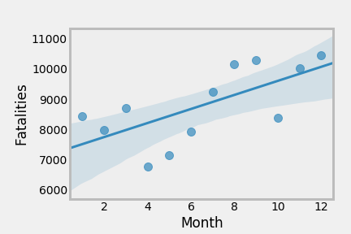
Fatalities By Month

Slide 8
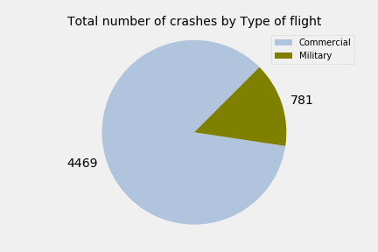
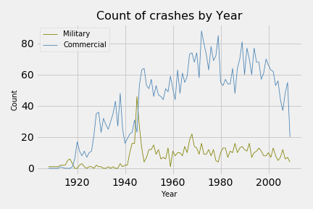
Military vs Commercial Crashes
Do Commercial and Military crashes follow the same pattern over time?
Other than the spike in the1940’s, the crashes do not necessarily follow the same pattern.
Total Number of Crashes Military vs Commercial
Crashes by year military vs. Commercial

Slide 9
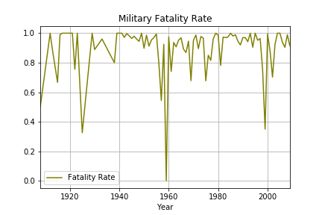
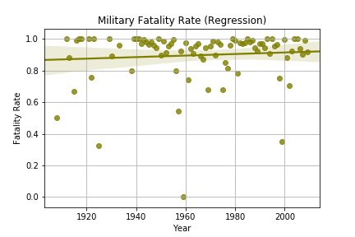
Military Fatality rate by year
The military fatality rate has a slight increase.
Fatality Rate percentage
Fatality Regression Model

Slide 10
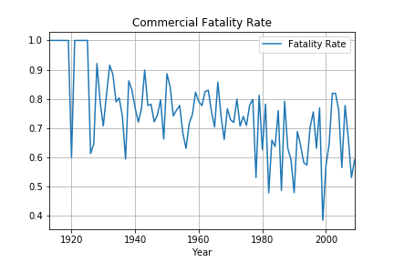
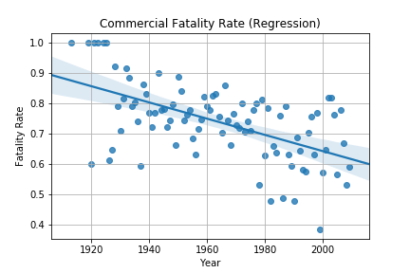
Commercial Fatality Rate by Year
You can see a clear downward trend.
Fatality rate Percentage
Fatality Regression Model

Slide 11
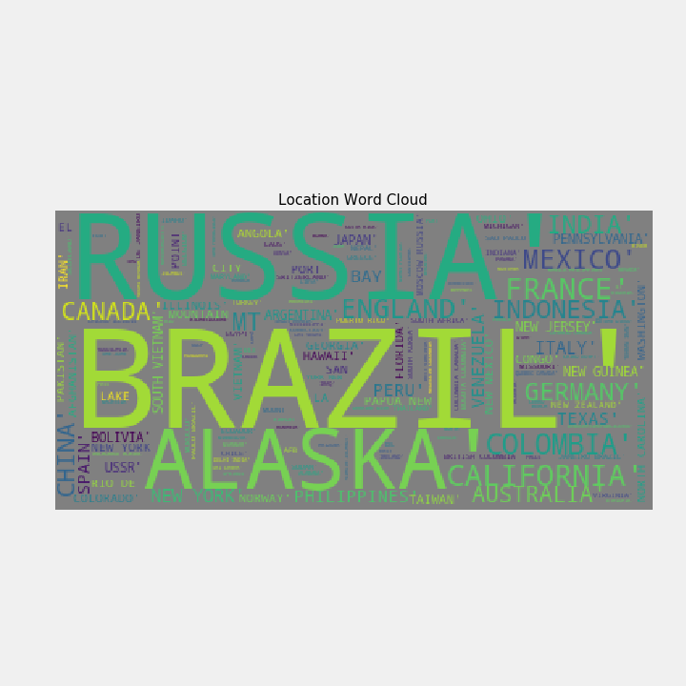
Dangerous Locations Word Cloud Think twice before traveling here ;)

Slide 12
Analysis of Historical Airplane Crashes
We started off asking if crash location has anything to do with the actual crash cause?
We found that when we grouped by location and number of crashes that it seems that based on this chart that areas that are more prone to inclement weather such as snow or wind seem to have more crashes. This led us to believe that weather might be a factor in causing airplane crashes.
Is there a correlation between the highest number of operator crashes and operator fatalities?
We found that only three of the top operators with the highest number of crashes are military. Among the operators with the most fatalities, the majority have a fairly good survival rate.
Side note: Aeroflot is one of t he oldest Airlines in the world, starting in 1923. During the Soviet Era, Aeroflot was the Soviet national airline and the largest airline the world. This airline was used for military and commercial flights.
Do Military and Commercial Crashes follow the same pattern overtime?
We found that military crashes spiked in the early1940’s, due to World War II. While commercial crashes spiked later in the 1940’s and early 1950’s. There was an uptick in commercial flights at that time and this was known as the “Golden Age of Flight”.

Slide 13
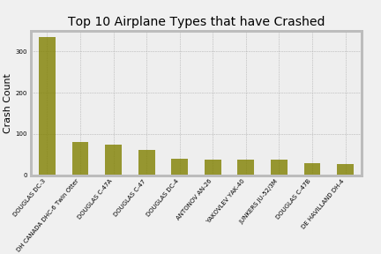
Top 10 Airplanes Types that have crashed

